Slide 1
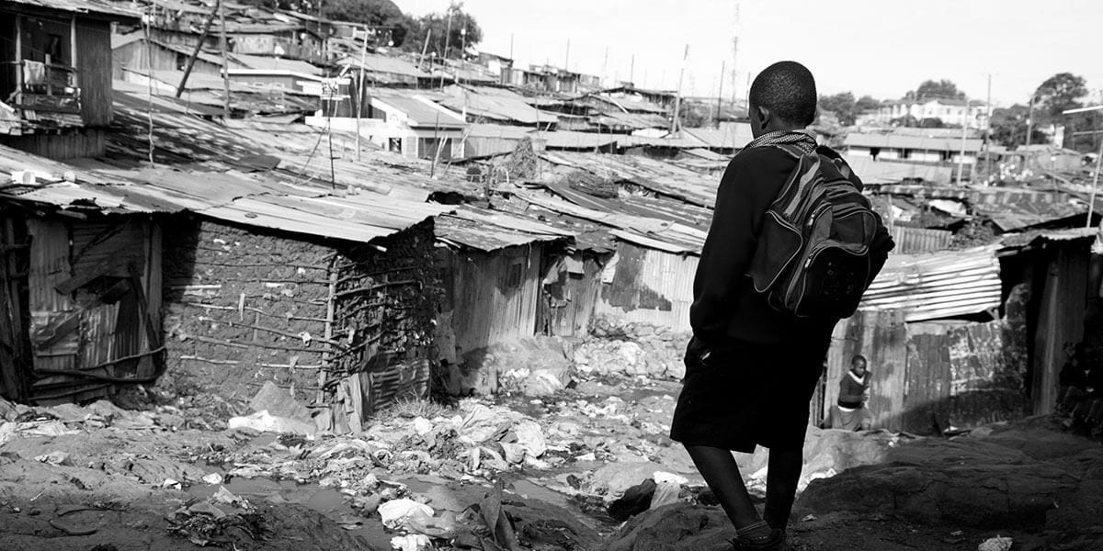


Multi-
Dimensional Poverty Index Analysis Report
Samuel Zhang Jonathan Wen James Begin William Clarke

Slide 2
01
Offerings
Poverty Index and Indicator Selection

Slide 3
Multidimensional Poverty Index
Basic Infrastructure
Education and Economics
Demographics
Access to electricity
Access to clean fuels and tech for cooking
Basic sanitation services
These indicators represent the foundation of a healthy and safe society.
Proper electricity and clean fuels can help prevent against pollutants, lowering the risk of cancers and lung diseases. While proper sanitation protects against transmitted disease.
Years of compulsory education
Wage & Salary Workers
Income per Capita
Education is key to human capital development while economic factors provide insight into the financial well-being of a population
Education and financial stability is key to poverty reduction. Education brings greater employment opportunities, lower fertility rates, and more.
Age Dependency Ratio
Adolescent Fertility
Balanced social and demographics are crucial to a stable society.
High dependency ratios can signal potential social support requirements, while adolescent fertility can lead to increased infant mortality and lesser employment and education opportunities for young women.
Aumi Ichiki Personal Training 20XX

Slide 4
Index Weighting
Demographics: 21.41%
Age Dependency: 12.69%
Adolescent Fertility: 8.72%
Basic Foundations: 45.24%
Basic Sanitation: 15.71%
Access to Electricity: 15.19%
Access to Clean Fuels: 14.34%
Education & Economics: 33.35%
Wage & Salary Workers: 13.13%
Income per Capita: 11.94%
Compulsory Education: 8.28%
Aumi Ichiki Personal Training 20XX

Slide 5
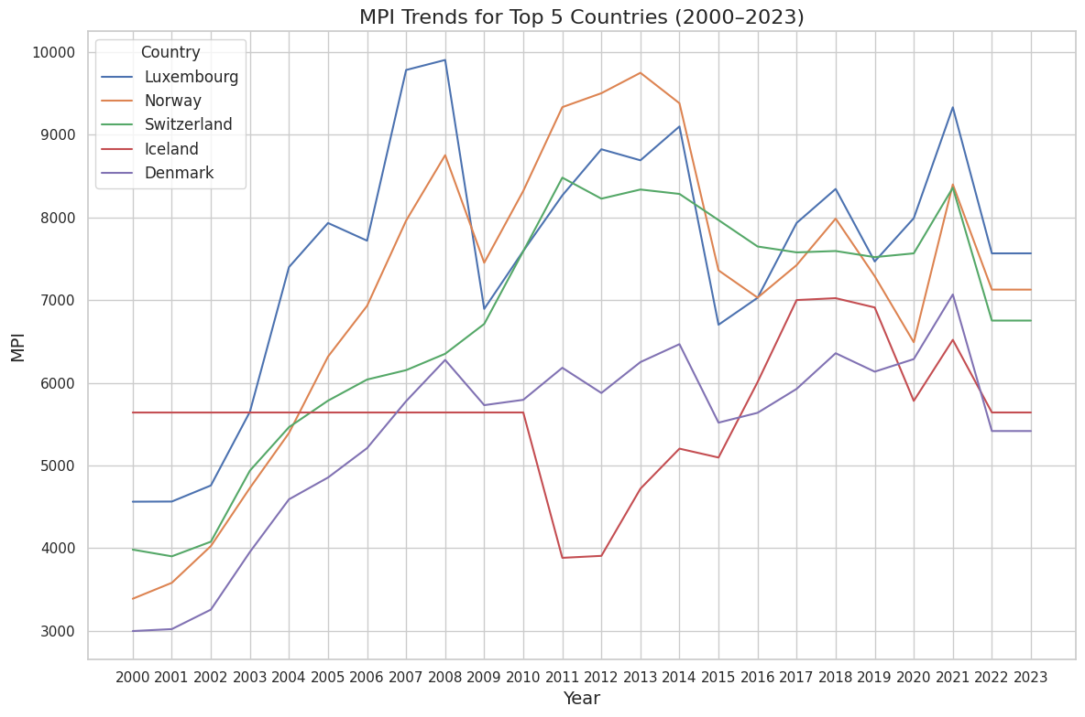
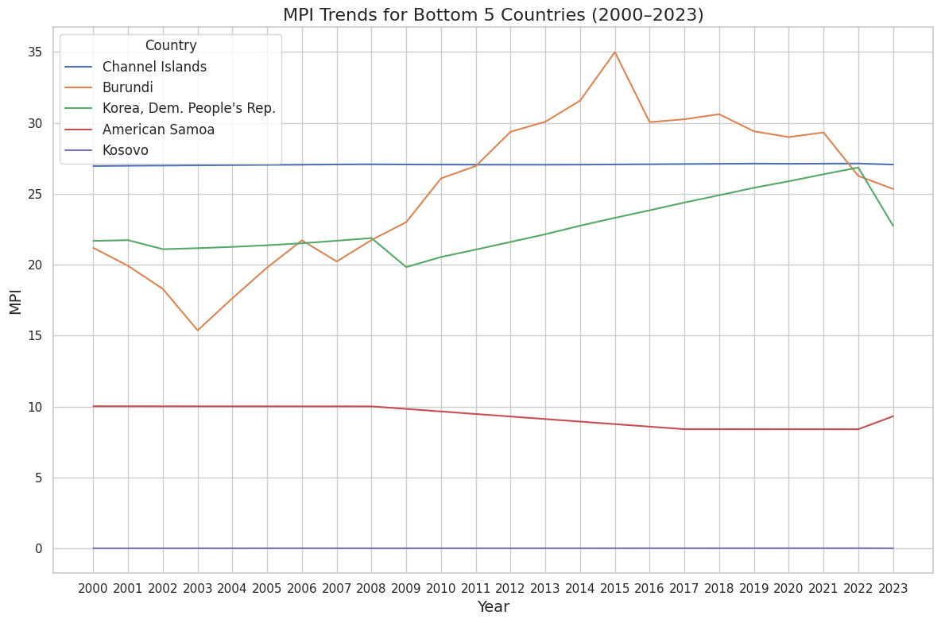
Top 5 Least Impoverished Countries
As of 2023, the least impoverished countries are Luxembourg, Norway, Switzerland, Iceland, and Denmark. Notice that these countries are mostly European/Scandinavian and have near perfect scores on foundational indicators with most variation due to Income per Capita
Top 5 Most Impoverished Countries
As of 2023, the most impoverished countries are the Channel Islands, Burundi, North Korea, American Samoa, and Kosovo. One common trend among these countries is that they fail to report key foundational data.
Aumi Ichiki Personal Training 20XX

Slide 6
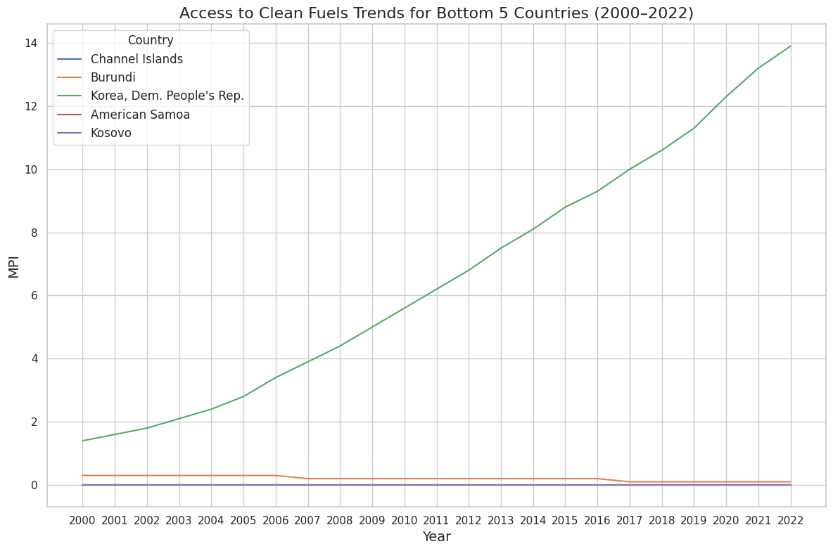
Sustainability & Poverty
Access to Clean Fuels and Heating
One notable difference between the most and least impoverished countries is ease of access to energy. Countries like Norway and Iceland produce their electricity through hydro and geothermal which are stable and reliable.
Bottom ranked countries like Burundi and Kosovo have low access to electricity, meaning that many rely on biomass such as burning wood or coal for the majority of energy needs.
These forms of energy are unreliable and exposes many to price shocks, causing more time and income to be spent on energy and heating.
Aumi Ichiki Personal Training 20XX

Slide 7
02
Offerings
Influential Indicators & Analysis

Slide 8
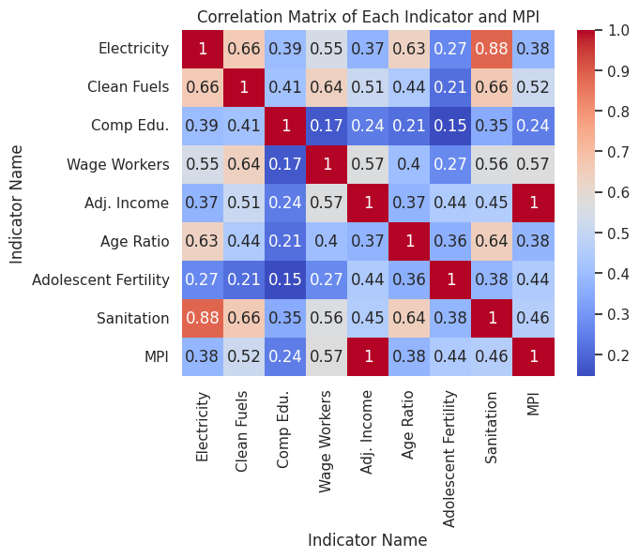
Correlation Analysis
When comparing each of the chosen indicators to the overall MPI, mostly have a moderate to strong correlation.
Noticeably, Income per Capita is perfectly correlated to MPI, while compulsory Education in years is the least correlated.
Further, the lowest correlation is between Education and Adolescent Fertility and Wage Workers. Given the expected links and relationships between these indicators, we would expect a greater correlation.
Aumi Ichiki Personal Training 20XX

Slide 9
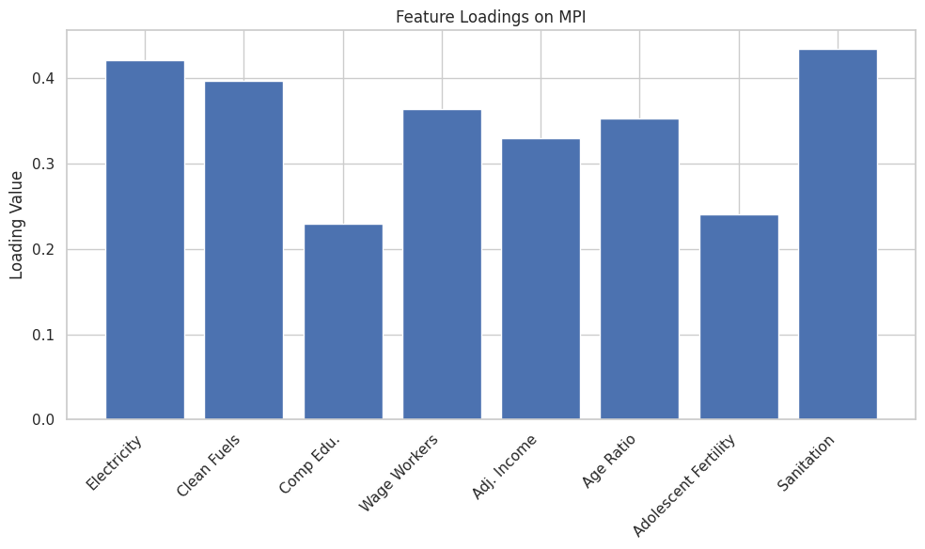
PCA Analysis
When analyzing the loadings for the MPI, most indicators are moderately influential with values of >0.3. The most influential indicator being Basic Sanitation followed by Access to Electricity and Clean Fuels.
Notably, we find that both Compulsory Education and Adolescent Fertility rates are the least influential indicators, similar to the findings in the previous Correlation Matrix.
Aumi Ichiki Personal Training 20XX

Slide 10
03
Offerings
Policy Recommendations

Slide 11
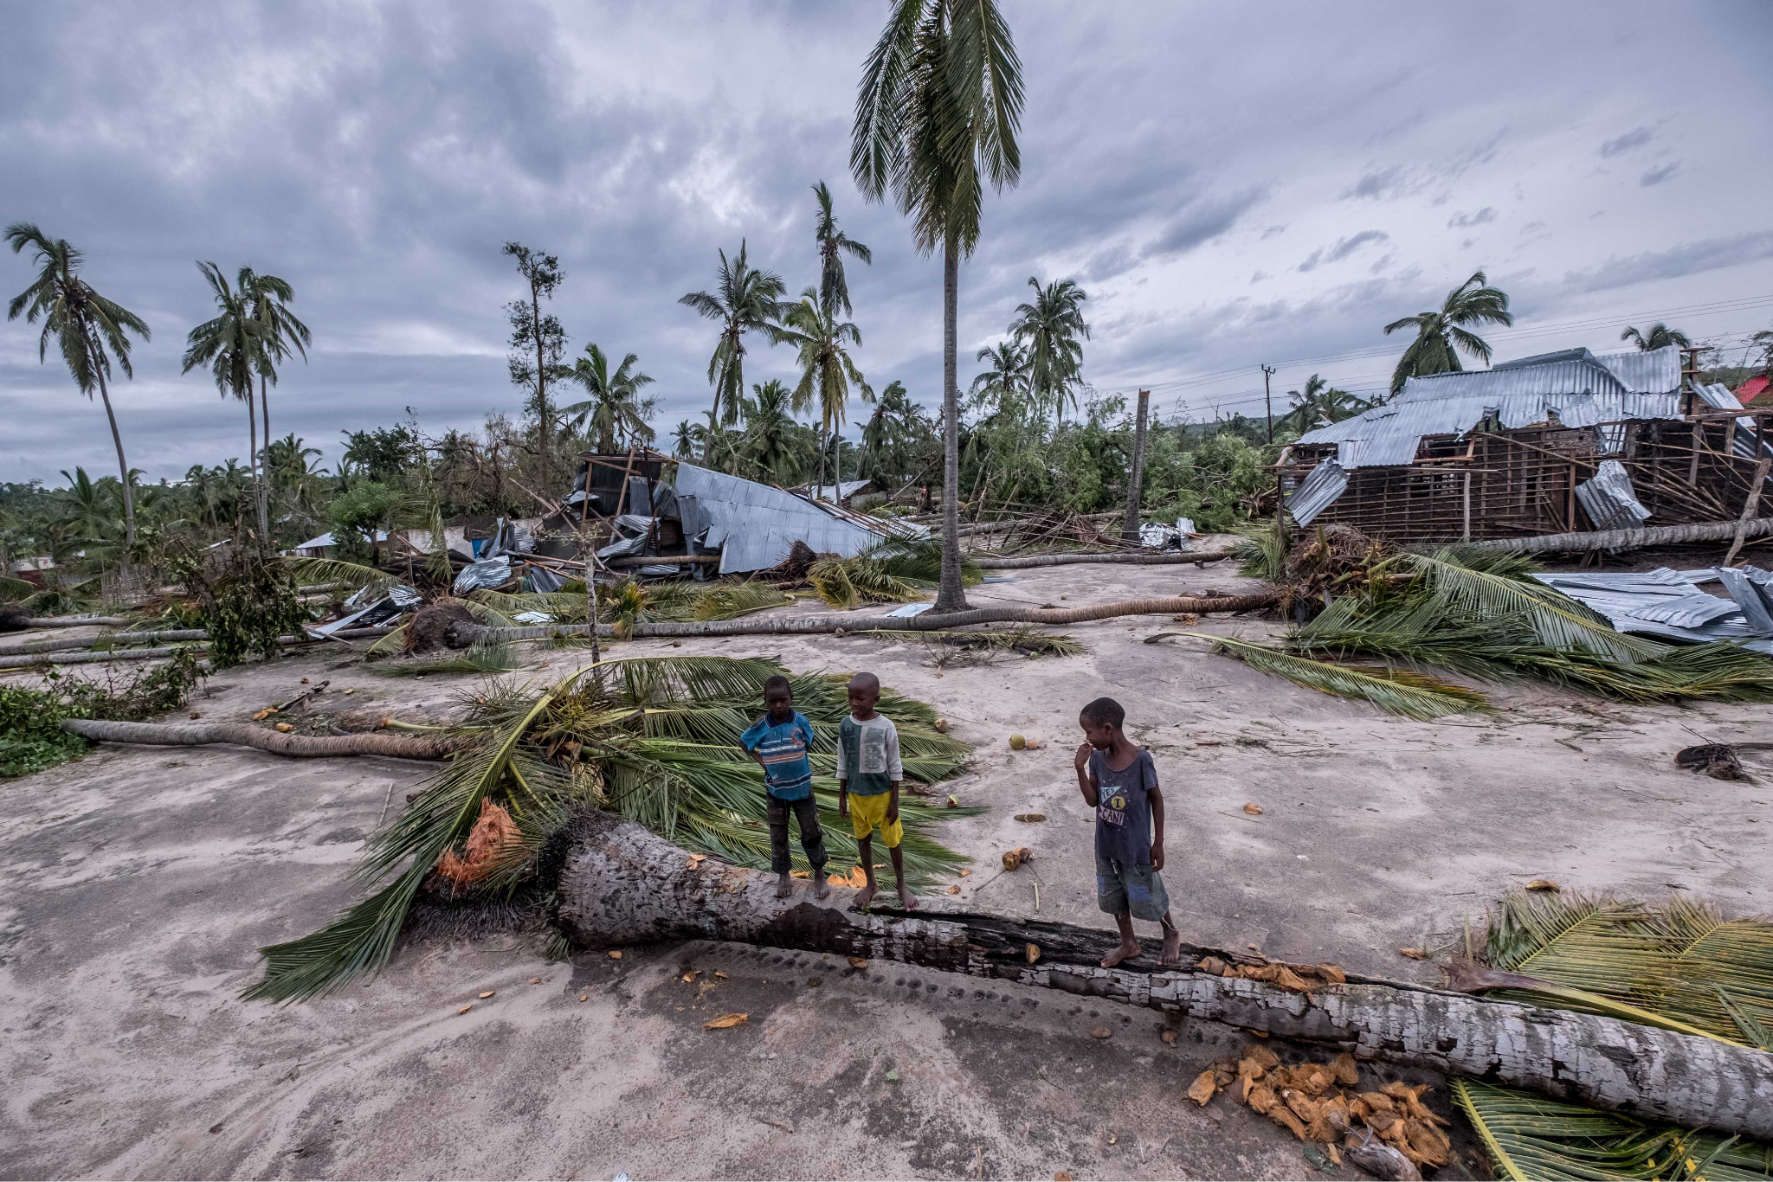
Climate Resilience
A large portion of the most impoverished countries by MPI are islands which are particularly susceptible to climate change.
Natural climate disasters such as floods, hurricanes, and earthquakes can cut off access to Electricity and Fuels, two of the most influential poverty indicators.
The majority of climate resilience can come in the form of planning and preparedness. Tools like early warning systems and shelters can help protect people, while stronger infrastructure and flood defenses can protect critical infrastructure.
Aumi Ichiki Personal Training 20XX

Slide 12

Climate Resilience
SAP offers numerous technologies to help support governments and management.
Tools like Public Sector Management can help track funding and analyze expenses for governments, supporting the development of infrastructure.
SAP Customer Experience can also help modernize services by collecting and analyzing data on citizens to help improve valuable government services that are crucial to the economy and especially useful in disaster situations.
Aumi Ichiki Personal Training 20XX

Slide 13

Sustainable Tourism
Considering that Waged Workers and Income are key influential poverty indicators, we want to encourage economic activity and business in these areas.
Many of the most impoverished countries possess existing wildlife and locations suitable for tourism. Sustainable tourism initiatives aim to promote tourism while protecting the surrounding land and resources. Tourism also does not require extensive education or training.
Tools like SAP Concur Travel and Expense can help improve accessibility and implementation of sustainable practices for these small countries.
Aumi Ichiki Personal Training 20XX

